Slide 1
HR ANALYSIS (EMPLOYEE RETENTION )
DA_P376 GROUP – 6 (PROJECT TEAM MEMEBERS)
Mr. Shreyash Choraghe
Mr. Akshay Khade
Mr. Vaibhav Patil
MR. KAUSHIK REDDY
Mr. RUTURAJ KOLHAR
Mr. Shivam Jawale

Slide 2
INDEX
INTRODUCTION
KPI -1 : Average Attrition rate for all Departments.
KPI -2 : Average Hourly rate of Male Research Scientist.
KPI -3 : Attrition rate Vs Monthly income stats.
KPI -4 : Average working years for each Department.
KPI -5 : Job Role Vs Work life balance.
KPI -6 : Attrition rate Vs Year since last promotion relation.
Excel Dashboard.
Tableau Dashboard.
Power BI Dashboard.
SQL .
Challenges faced.
Conclusion.

Slide 3
INTRODUCTION
HR analytics allows HR professionals to make informed decisions and create strategies that will benefit employees and support organizational goals. This has a significant impact on organizational performance, leading to rise in business productivity, and decrease in attrition rates, and increase recruiting efficiency.
It is the method of getting a better understanding of the people within an organization and how well the human resources team is performing.
HR analytics deals explicitly with the metrics of the HR functions, All these metrics are managed exclusively by HR, and Data analytics in HR is used to improve HR functions in a variety of ways.

Slide 4
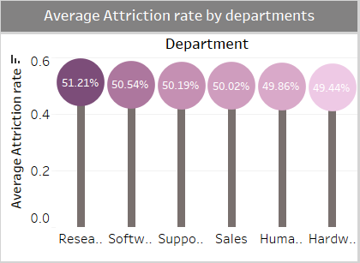
KPI - 1 : Average Attrition rate for all Departments.
From all the departments, Attrition is higher in the Research department which is 51.21%
Least Attrition: Hardware department which is 49.44%
Higher male attrition: Software department 51.52%
Higher female attrition: Research department 51.72%
Overall Attrition rate: 50.21%
Recommendations :
We can reduce employee attrition and retain employees by overcoming low pay, addressing poor work-life balance, creating career growth opportunities, offering flexible work arrangement.

Slide 5
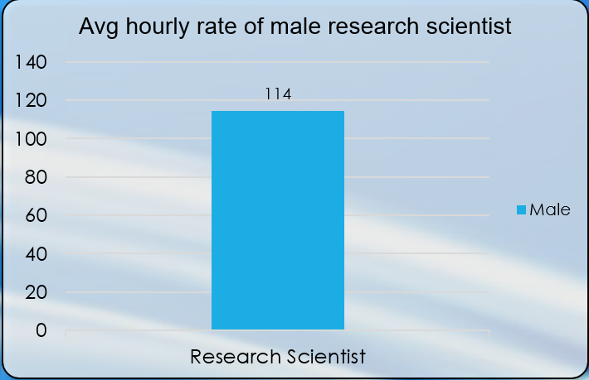
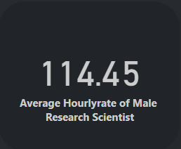
KPI - 2 : Average Hourly rate of Male Research Scientist.
A male research scientist earns about an average of $114 per hour.

Slide 6
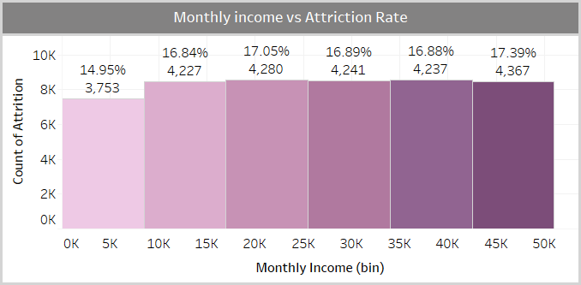
KPI - 3 : Attrition rate Vs Monthly income stats.
Higher Attrition rate of 17.39% between monthly income 42.5K to 50K,And 17.05% between income 17K to 25.5K
Lower attrition rate of 14.95% for monthly income lower than 10K
Total Attritions : 25105
Recommendations :
Despite of high income attrition are more here which indicates income is not the only sole for happening attrition, and need to focus on other factors like job satisfication, work life balance, career development opportunities which are equally important in retaining employees.

Slide 7
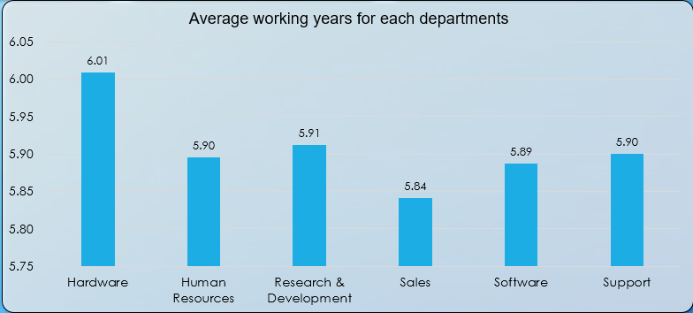
KPI - 4 : Average working years for each Department.
Higher average of working years for departments
Hardware 6.01 years
Research & development 5.91 years
Lesser average of working years for sales Departments 5.84 years
All departments are having low average of working years except hardware and research & development.
Recommendations :
We can improve the working years of employees by lower overall stress, offering career growth opportunities

Slide 8
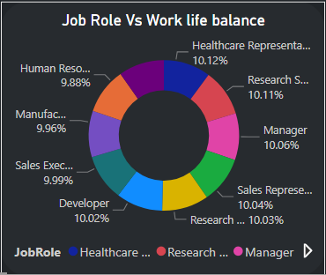
KPI - 5 : Job Role Vs Work life balance.
Healthy Work life balance for job roles
Healthcare representative 10.12%
Research Scientist 10.11%
Manager 10.06%
Developer 10.02%
Sales representative 10.04%
research director 10.03%
Weak Work life balance for job roles
Human Resource 9.88%
Laboratery technician 9.70%
Manufacturing director 9.96%
Sales executive 9.99%
Recommendations :
Should focus on improving work life balance by promoting boundaries, prioritizing task, encourage time off, by encouraging breaks and downtime.

Slide 9
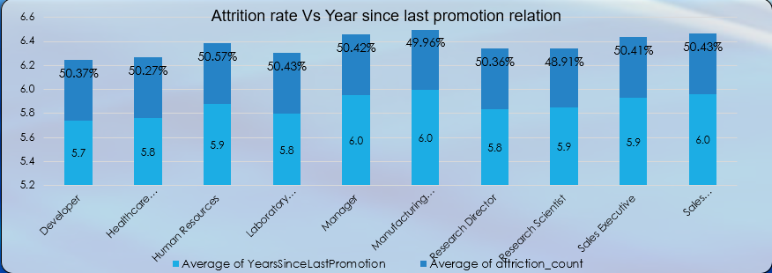
KPI - 6 : Attrition rate Vs Year since last promotion relation.
Jobroles with Higher attrition for high average values of last promotion
jobrole | Average Yrs since last promotion | Attrition
manager | 6.0 | 50.42%
Sales Representative | 6.0 | 50.43%
Jobroles with lower attrition for low average values of last promotion
Recommendations :
Jobrole | Average Yrs since last promotion | Attrition
Healthcare Representative | 5.8 | 50.27%
Research scientist | 5.9 | 48.91%
Attrition can be reduced by making improvement in reducing delays in the employees promotions which motivates employee to stay long term with organization.

Slide 10
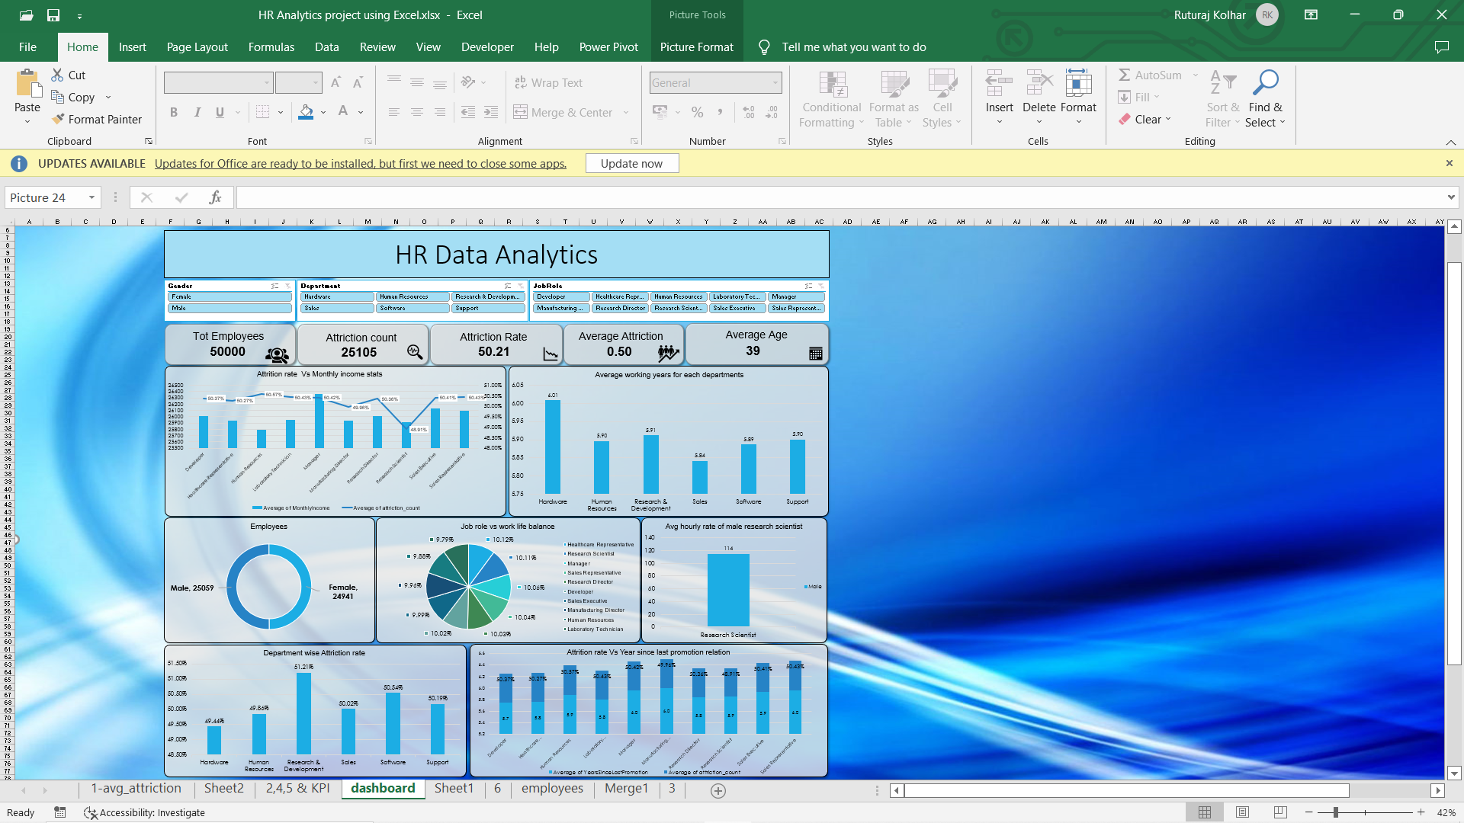
EXCEL DASHBOARD

Slide 11
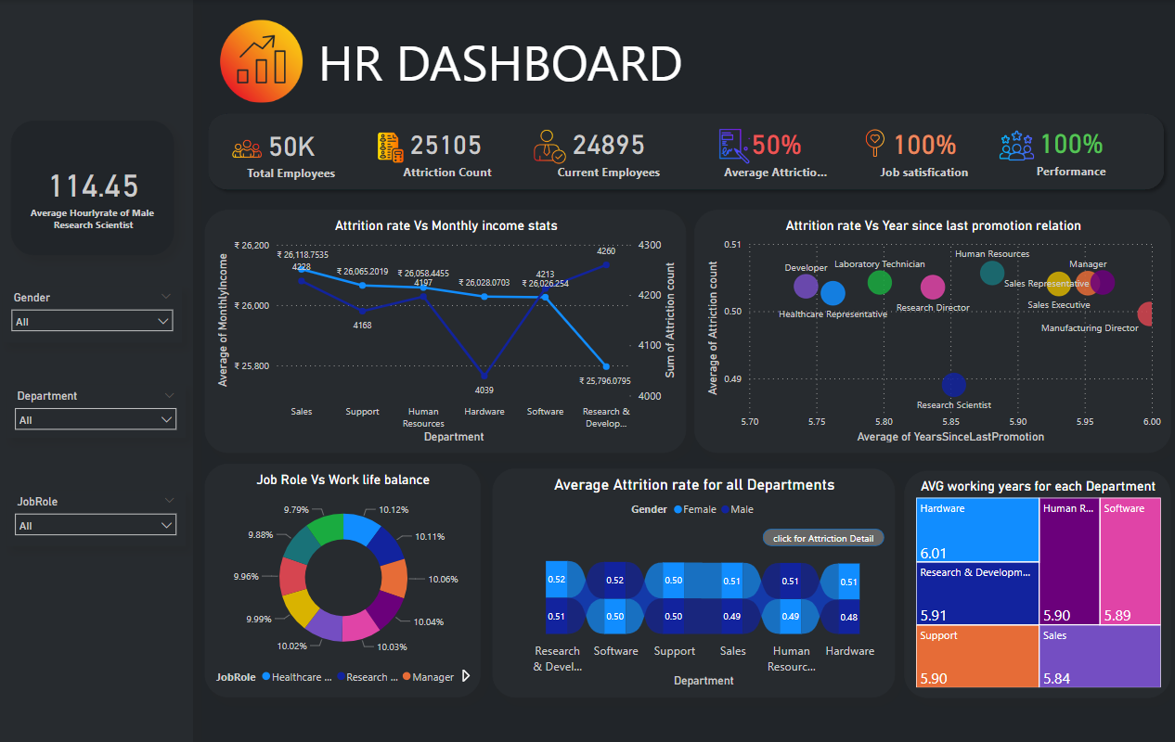
POWERBI DASHBOARD

Slide 12
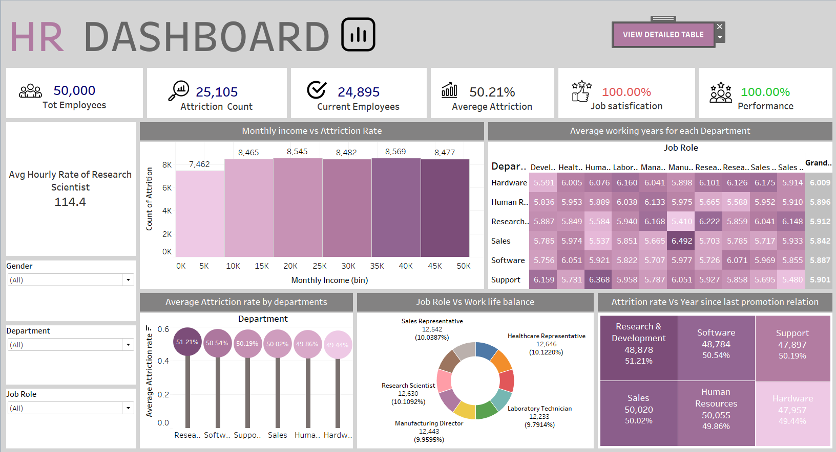
TABLEAU DASHBOARD

Slide 13
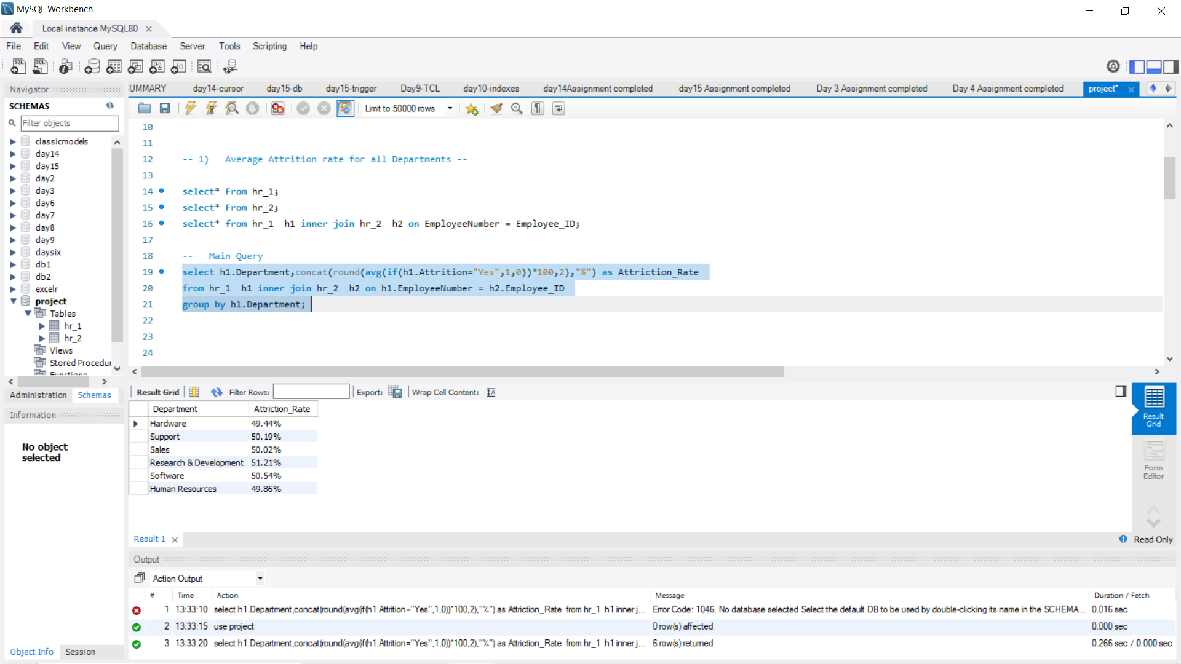
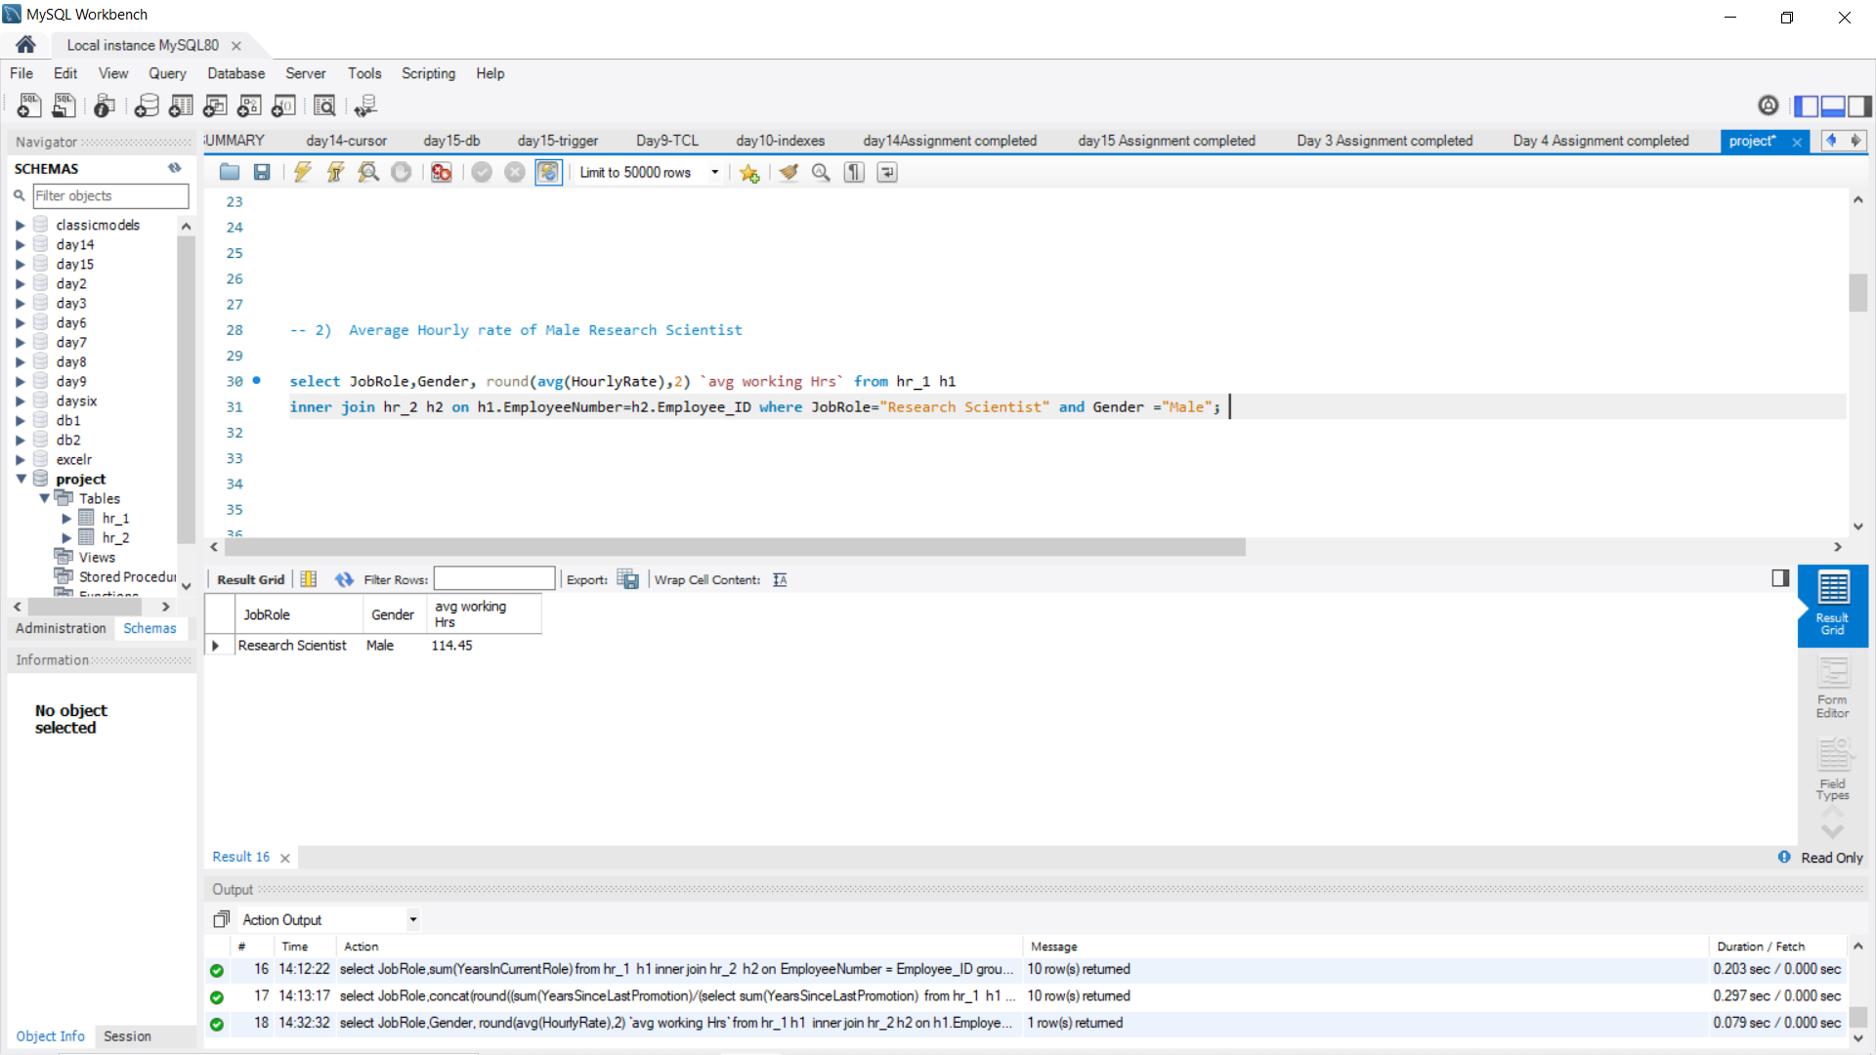
SQL QUERY
KPI -1 : Average Attrition rate for all Departments.
KPI -2 : Average Hourly rate of Male Research Scientist.
Department | Attrition rate
Hardware | 49.44%
Support | 50.19%
Sales | 50.02%
Research & Development | 51.21%
Software | 50.54%
Human Resources | 49.86%
JobRole | Gender | Avg working hours
Research Scientist | Male | 114.45

Slide 14
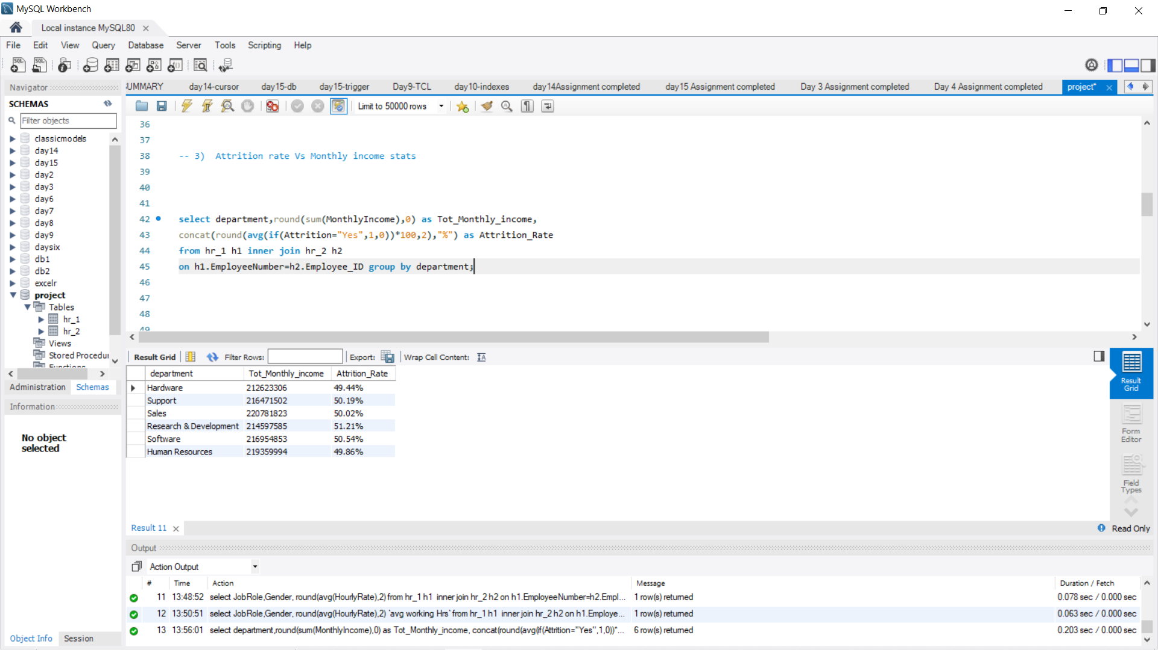
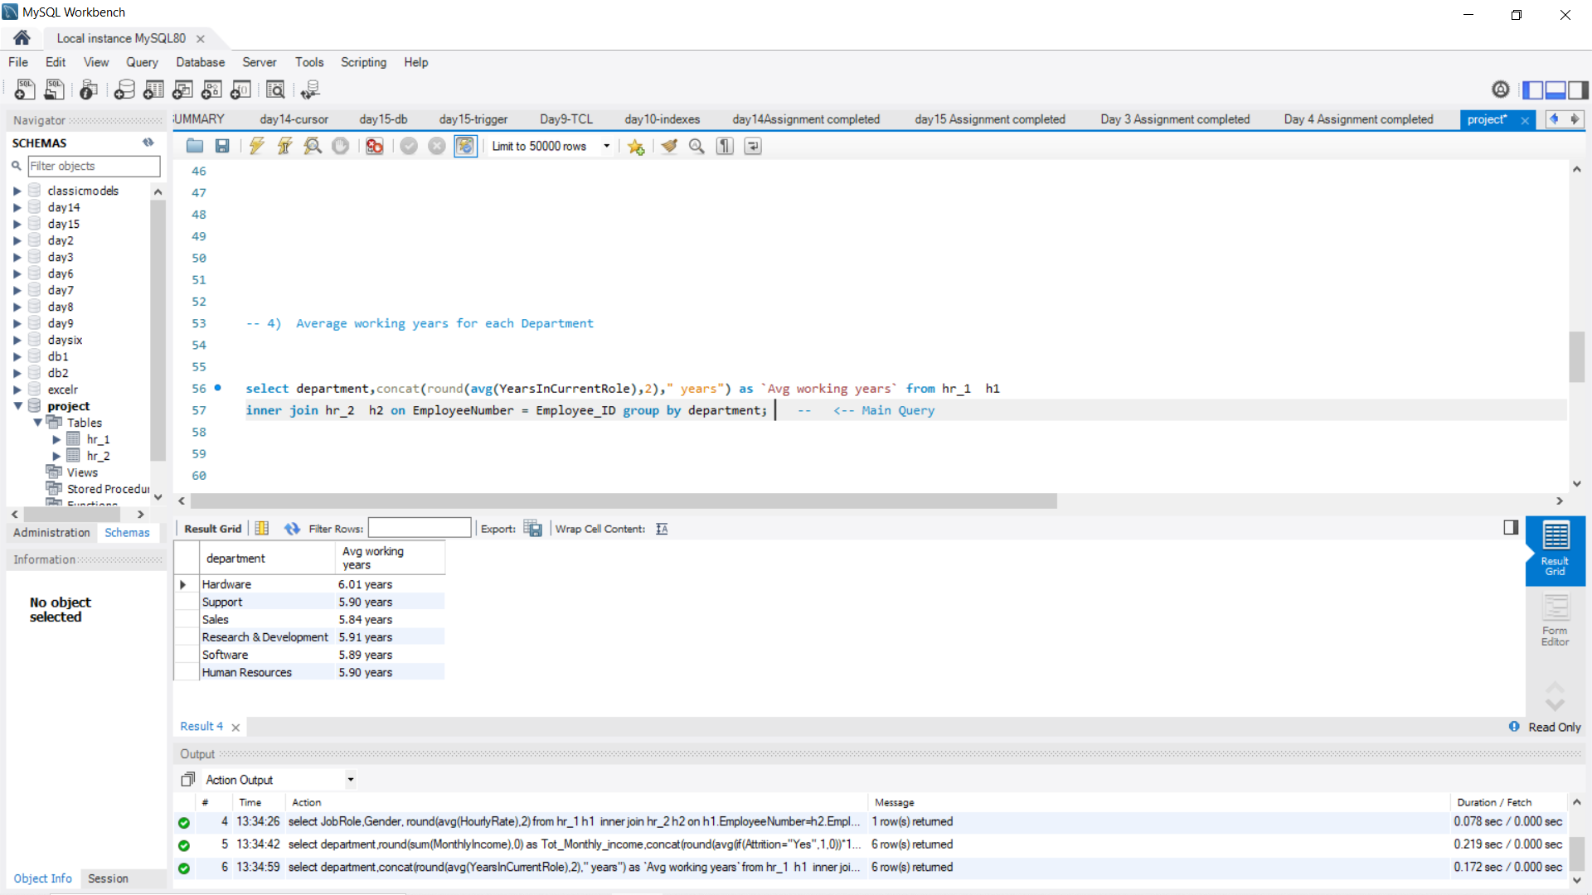
SQL QUERY
KPI -3 : Attrition rate Vs Monthly income stats.
KPI -4 : Average working years for each Department.
Department | Total Monthly Income | Attrition Rate
Hardware | 212623306 | 49.44%
Support | 216471502 | 50.19%
Sales | 220781823 | 50.02%
Research & Development | 214597585 | 51.21%
Software | 216954853 | 50.54%
Human Resources | 219359994 | 49.86%
Department | Avg working years
Hardware | 6.01 years
Support | 5.90 years
Sales | 5.84 years
Research & Development | 5.91 years
Software | 5.89 years
Human Resources | 5.90 years

Slide 15
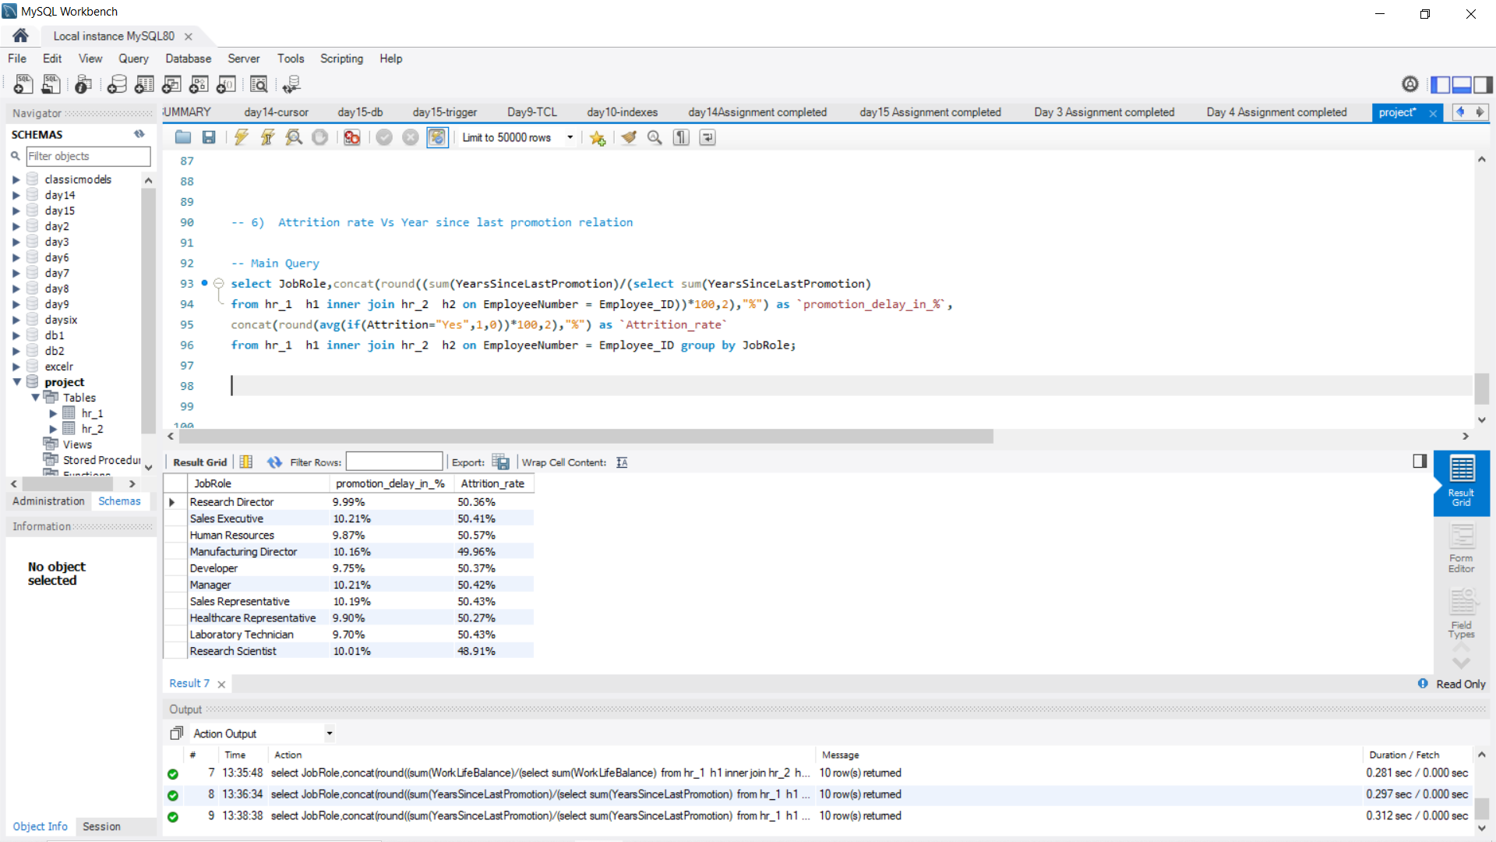
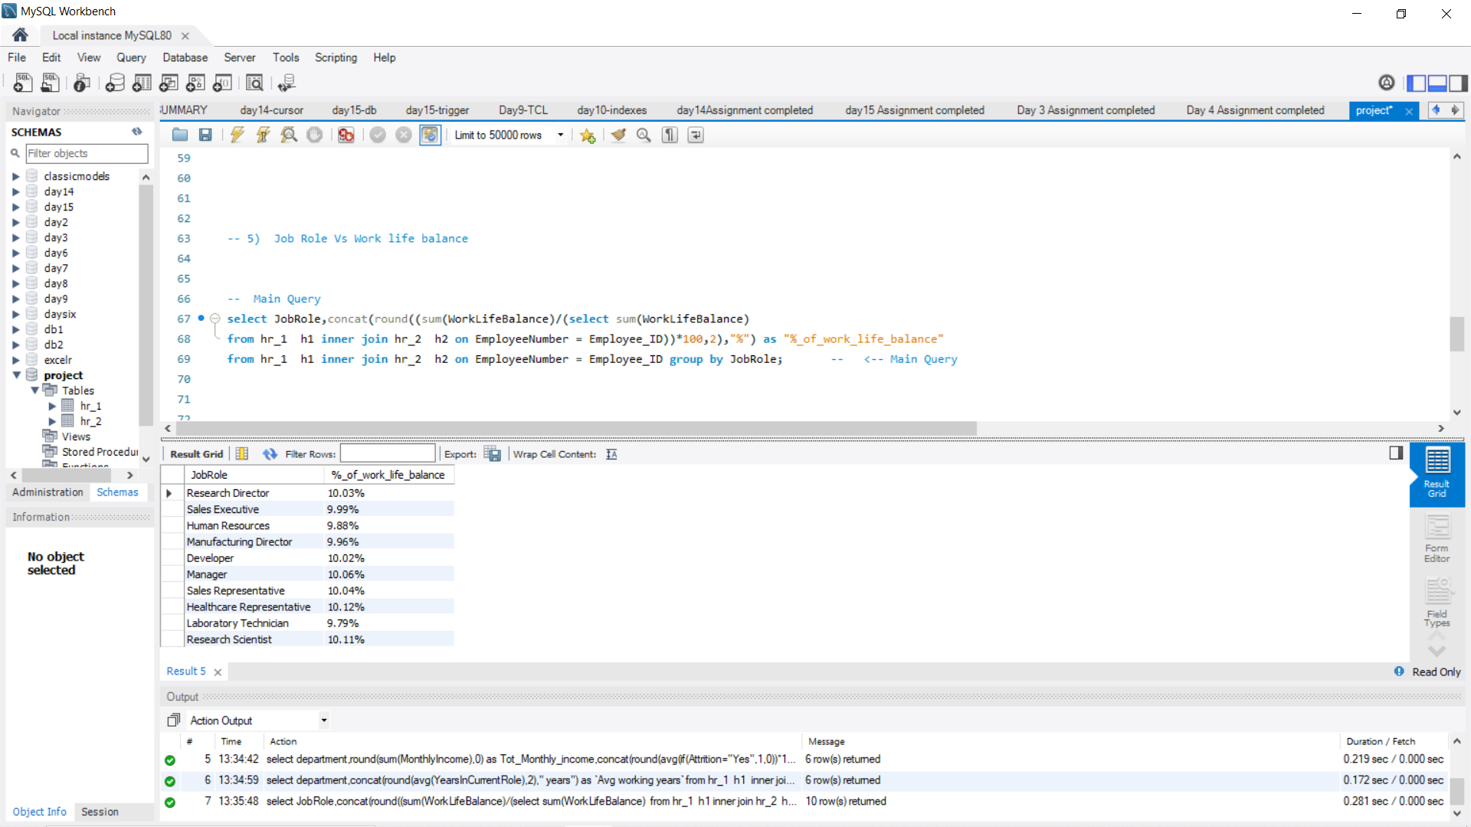
SQL QUERY
KPI -6 : Attrition rate Vs Year since last promotion relation.
KPI -5 : Job Role Vs Work life balance.
JobRole | % Of Work Life Balance
Research Director | 10.03%
Sales Executive | 9.99%
Human Resources | 9.88%
Manufacturing Director | 9.96%
Developer | 10.02%
Manager | 10.06%
Sales Representative | 10.04%
Healthcare Representative | 10.12%
Laboratory Technician | 9.79%
Research Scientist | 10.11%
JobRole | Promotion delay in % | Attrition rate
Research Director | 9.99% | 50.36%
Sales Executive | 10.21% | 50.41%
Human Resources | 9.87% | 50.57%
Manufacturing Director | 10.16% | 49.96%
Developer | 9.75% | 50.37%
Manager | 10.21% | 50.42%
Sales Representative | 10.19% | 50.43%
Healthcare Representative | 9.90% | 50.27%
Laboratory Technician | 9.70% | 50.43%
Research Scientist | 10.01% | 48.91%

Slide 16
CHALLENGES FACED
Working with categorical column of attrition to carryout calculation operations was tough and challenging part for us, so as a team we discussed and finded out the solution which helped us to work with ease and where out of such situation.

Slide 17
CONCLUSION
Human Resource (HR) Analytics is a crucial tool that enables HR professionals to make data-driven decisions related to employee behaviour, performance, and engagement to improve organizational performance. working on such data helped us in understanding various Hr metrics and concepts. This knowledge enables us to deliver proper insights which guides Hr in making decision which contributes in both employee satisfication & business growth.
The Addressing and implementation of KPI’s enhanced our expertise in using different analysing tools, DAX calculations, extracting, and modelling techniques.

Slide 18
Thank
You

